Slide 1



Image Animation using Deepfake Technology
Hitesh
A023119820027
B.Tech AI
2020-2024

Slide 2

Problem Statement
Across various applications, a demand is emerging for advanced image animation utilizing deepfake techniques.
This calls for innovative solutions to extract motion data efficiently, create lifelike animations, and harness advantages like improved advertising and dynamic visual content.
As industries seek to enhance engagement and experiences, addressing these challenges becomes pivotal in meeting the evolving demands of modern content consumption.

Slide 3
What is a Deepfake?
Deep Fakes are videos or images that replace someone’s likeness with someone else.
It is the next level of fake content creation that takes advantage of artificial intelligence (AI).
The phenomenon gained its name from a user of the Reddit platform, who went by the name “deepfakes” – (deep learning + fakes).

Slide 4
Objectives
1. Realistic Animation: The main goal is to produce realistic animations of the highest calibre that smoothly transfer motion from a driving video to a target image. The objective is to produce animations that move fluidly and naturally, capturing the spirit of the source material.
2. Dynamic Visual Content: Using deepfake technology, static images are animated to create dynamic visual content. It improves narrative powers and engages viewers by adding movement and life to the visuals by animating previously static parts inside an image.
3. Interactive Experiences: Another goal is to use animation to make interactive experiences possible. The animation promotes user engagement and immerses users in dynamic virtual environments in applications such as gaming, virtual reality, and augmented reality.
4. Creative Expression: Deepfake-based image animation gives artists, designers, and content producers a platform for their creative expression by bringing life to their static graphics. By utilising the power of motion, it allows them to experiment with new types of visual storytelling and communication.
5. Seamless Integration: The driving video and the target image must be seamlessly integrated to achieve the goal. By preserving consistency and coherence between the motion carried over from the video and the static aspects of the image, the animation should appear as a logical extension of the original video.

Slide 5

Creating a Deepfake
The deepfake creation process requires three steps:
Extraction
Training
Creation

Slide 6
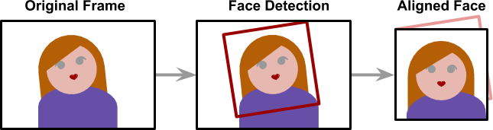
Extraction
Deepfakes leverage deep neural networks to transform faces and require large amounts of data (images) to make it all work smoothly and believable. The extraction process refers to the step of extracting all frames from video clips, identifying the faces and aligning them to optimize for performance.
The alignment is a critical step since the neural network that performs the faceswap requires all faces to have the same size (usually 256 x 256) and aligned features. Detecting and aligning faces is a problem that is considered mostly solved and is done by most applications very efficiently (face detection).

Slide 7
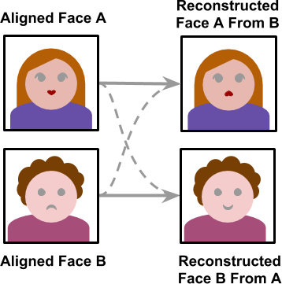
Training
The training stage allows the neural network to convert a face into another. The training may take several hours or even days depending on the size of the training set and the device the model is trained on. Like training most other neural networks the training only needs to be completed once. Once the model is trained it would be able to convert a face from person A to person B.

Slide 8
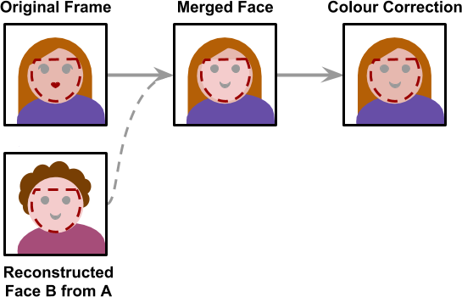
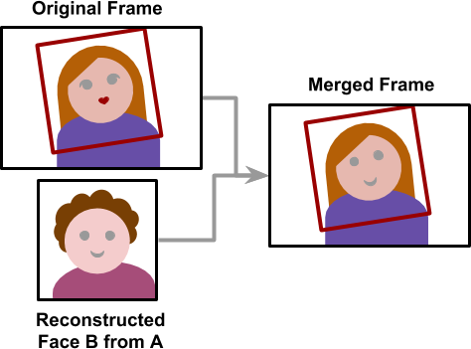
Creation
Once the model is trained, a deepfake may be created. Starting from a video, frames are extracted, and all faces are aligned. Each frame is then converted using the trained neural network. The final step is to merge the converted face back to the original frame.
The creation stage is the only one which does not make use of any machine learning algorithms. The process is to stich a face back onto an image is hard-coded and thus lacks the ability to detect mistakes.
Each frame is also processed independitly which means there is no temporal correlation. A temporal correlation function is a function that gives the statistical correlation between random variable, contingent on the temporal (time) distance between those variables. The lack of this correlation results in the final video having some flickering.

Slide 9
How Do DeepFakes work?

Slide 10
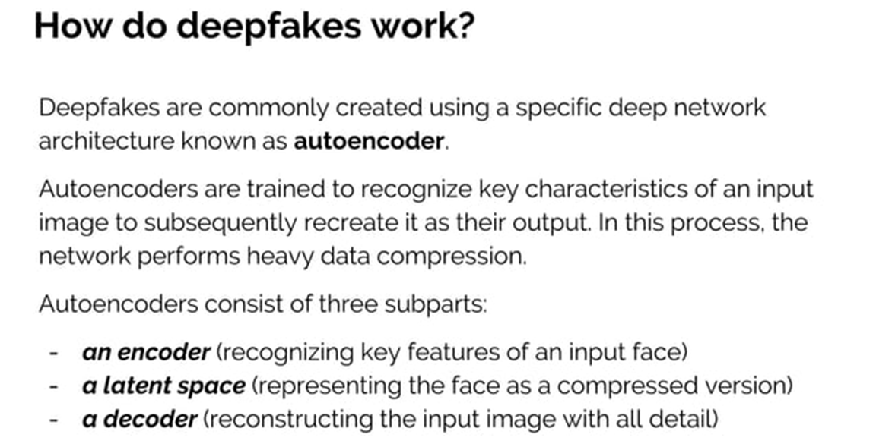

Slide 11
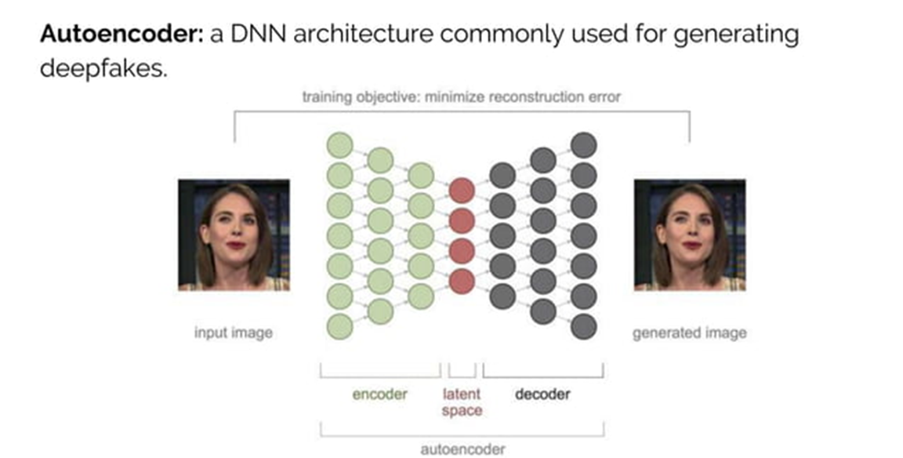

Slide 12
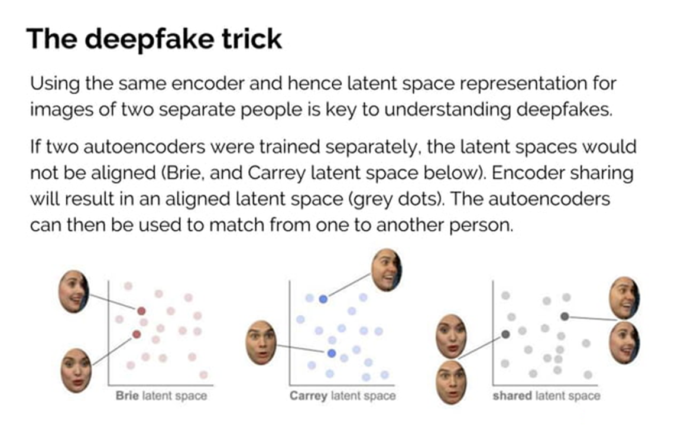

Slide 13
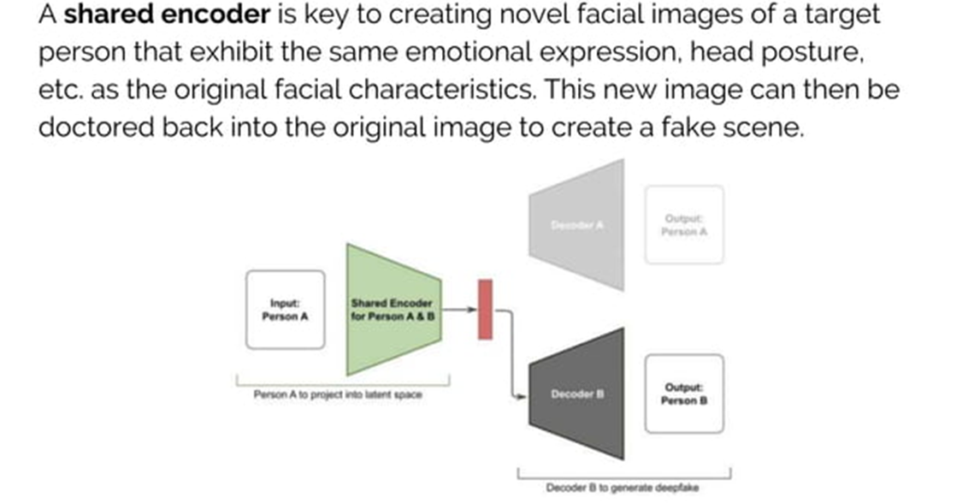

Slide 14
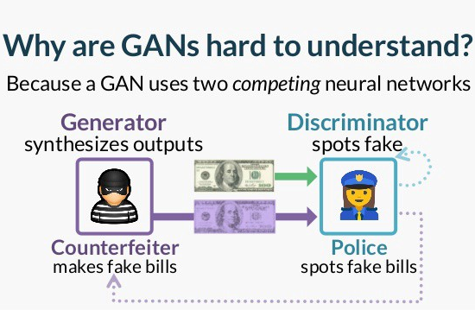
What is a Generative Adversarial Network (GAN)?
A generative adversarial network (GAN) is a computing procedure that uses two neural networks, which are considered “adversaries” of each other. These deep neural networks produce new and fabricated data that can easily mimic real information. In real life, GANs help in image, video, and voice generation. They are the very devices used to produce deep fakes.
You can consider the components of a GAN (the generator and the discriminator) as representations of a criminal and a cop, where the criminal mixes fake with real money for purchases. In contrast, the police detects which of the notes are counterfeit.

Slide 15
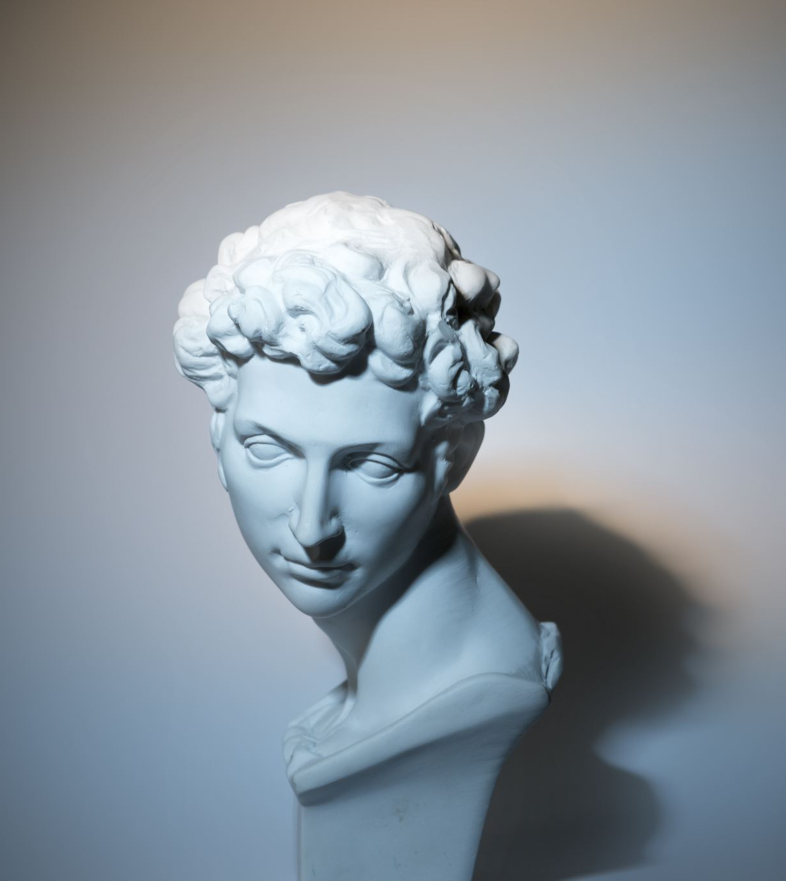
Pros of Deepfakes
Deepfakes can be used as a form of art to bring people from the past back to life. For example, a painting of the Mona Lisa can be used for generating a synthetic image of talking Mona Lisa as a form of art.
Deepfake technology can be used to create AI avatars in training videos. Startups like London-based Synthesia have been getting more attention from the corporate world during the COVID pandemic since lockdowns and health concerns have made video shoots involving real people much more difficult to pull off.
Deepfakes can be used to create personal avatars to try on clothes or new hairstyles before trying them in real.
Deepfakes can also be used in identity protection and anonymization in various fields like investigative news reporting, finance, etc.

Slide 16
Cons of Deepfakes
Deepfakes can be used to spread fake news with morphed videos of celebrities.
Deepfakes can also be misused for creating misinformation campaigns on social media that can shift public opinion and lead to negative consequences.

Slide 17
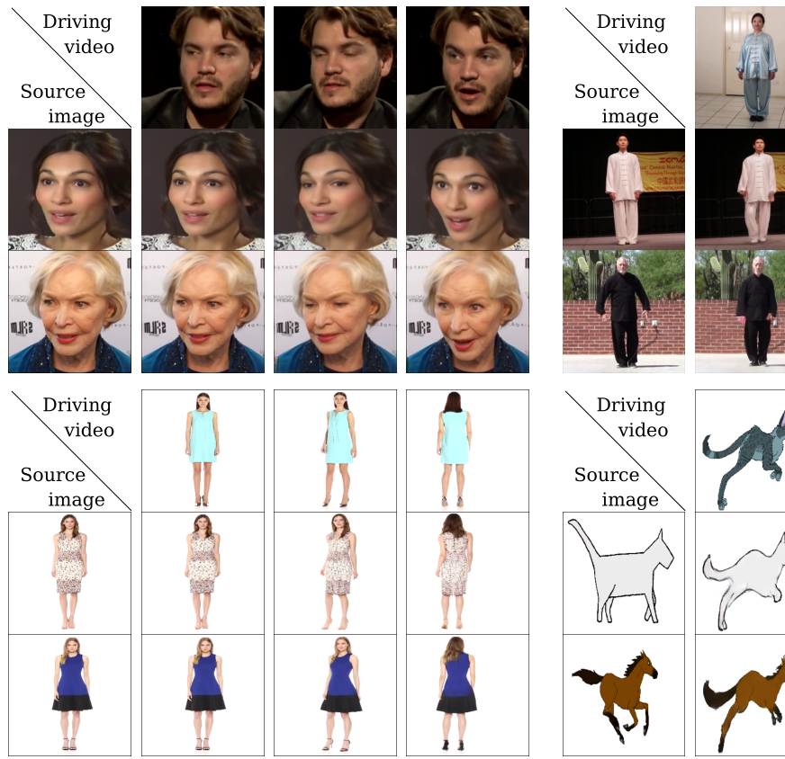
Dataset description
The model is trained over VoxCeleb dataset which is a face dataset. The 22496 videos in the VoxCeleb dataset are face-extracting videos from YouTube. In the first video frame, an initial bounding box has been extracted for pre-processing. This face is followed until it strays too far from its starting location. Then, the video frames are being cropped using the smallest crop that includes all the bounding boxes. Up until the end of the series, the process is repeated. Sequences with resolutions less than 256x256 are removed, and the remaining videos are scaled to 256x256 while maintaining the aspect ratio. It's noteworthy to notice that the employed Aliaksandr’s first order model produces more realistic movies with faces moving freely within the bounding box when compared to X2Face.

Slide 18

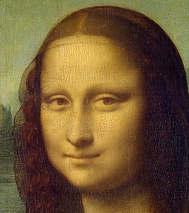
TARGET IMAGES

Slide 19
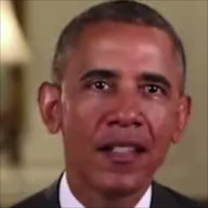
Driving Video

Slide 20

OUTPUTS
Original
DeepFake

Slide 21

Original
DeepFake

Slide 22
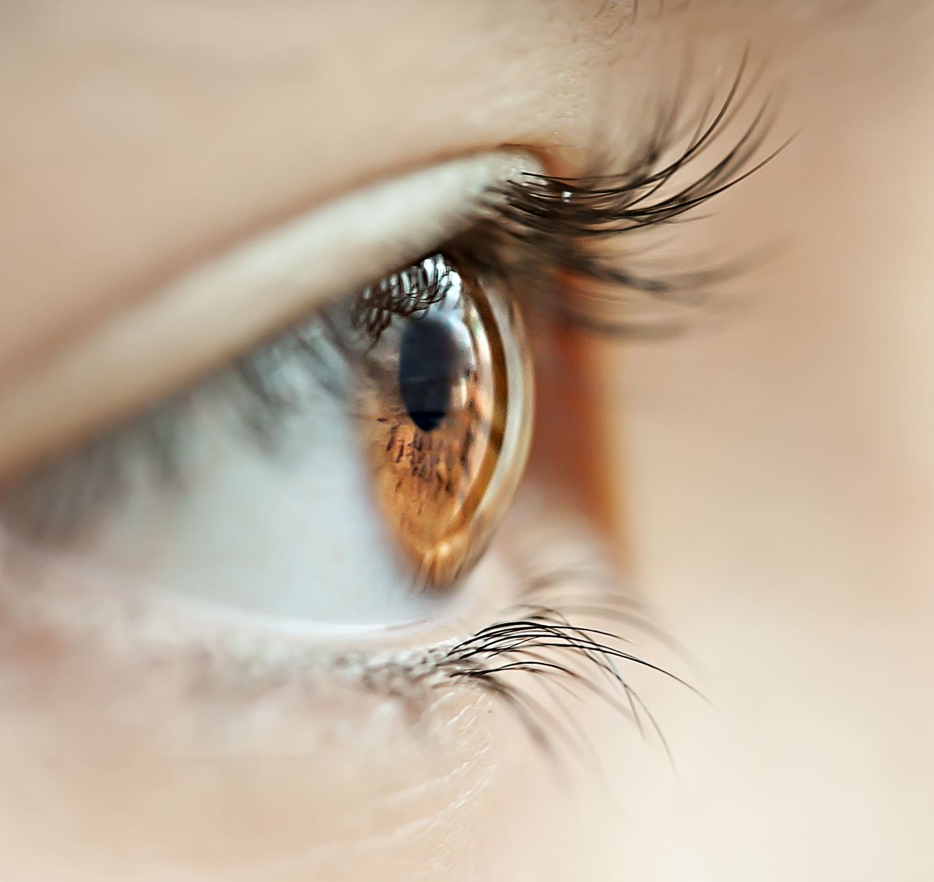
How to detect DeepFake?
Pay attention to the face. High-end DeepFake manipulations are almost always facial transformations.
Pay attention to the cheeks and forehead. Does the skin appear too smooth or too wrinkly? Is the agedness of the skin similar to the agedness of the hair and eyes? DeepFakes may be incongruent on some dimensions.
Pay attention to the eyes and eyebrows. Do shadows appear in places that you would expect? DeepFakes may fail to fully represent the natural physics of a scene.
Pay attention to the glasses. Is there any glare? Is there too much glare? Does the angle of the glare change when the person moves? Once again, DeepFakes may fail to fully represent the natural physics of lighting.
Pay attention to the facial hair. Does this facial hair look real? DeepFakes might add or remove a mustache, sideburns, or beard. But, DeepFakes may fail to make facial hair transformations fully natural.
Pay attention to facial moles. Does the mole look real?
Pay attention to blinking. Does the person blink enough or too much?
Pay attention to the lip movements. Some deepfakes are based on lip syncing. Do the lip movements look natural?
Notes:
https://www.scirp.org/journal/paperinformation.aspx?paperid=109149

Slide 23
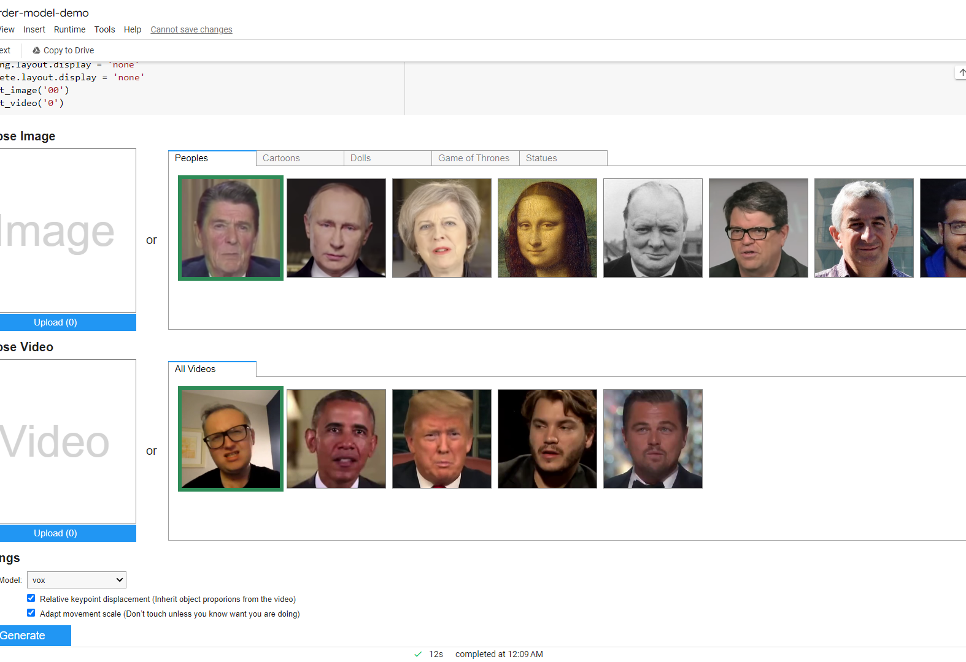
COLAB LINK FOR CODE
https://colab.research.google.com/github/AliaksandrSiarohin/first-order-model/blob/master/demo.ipynb#scrollTo=Oxi6-riLOgnm

Slide 24


